Slide 1
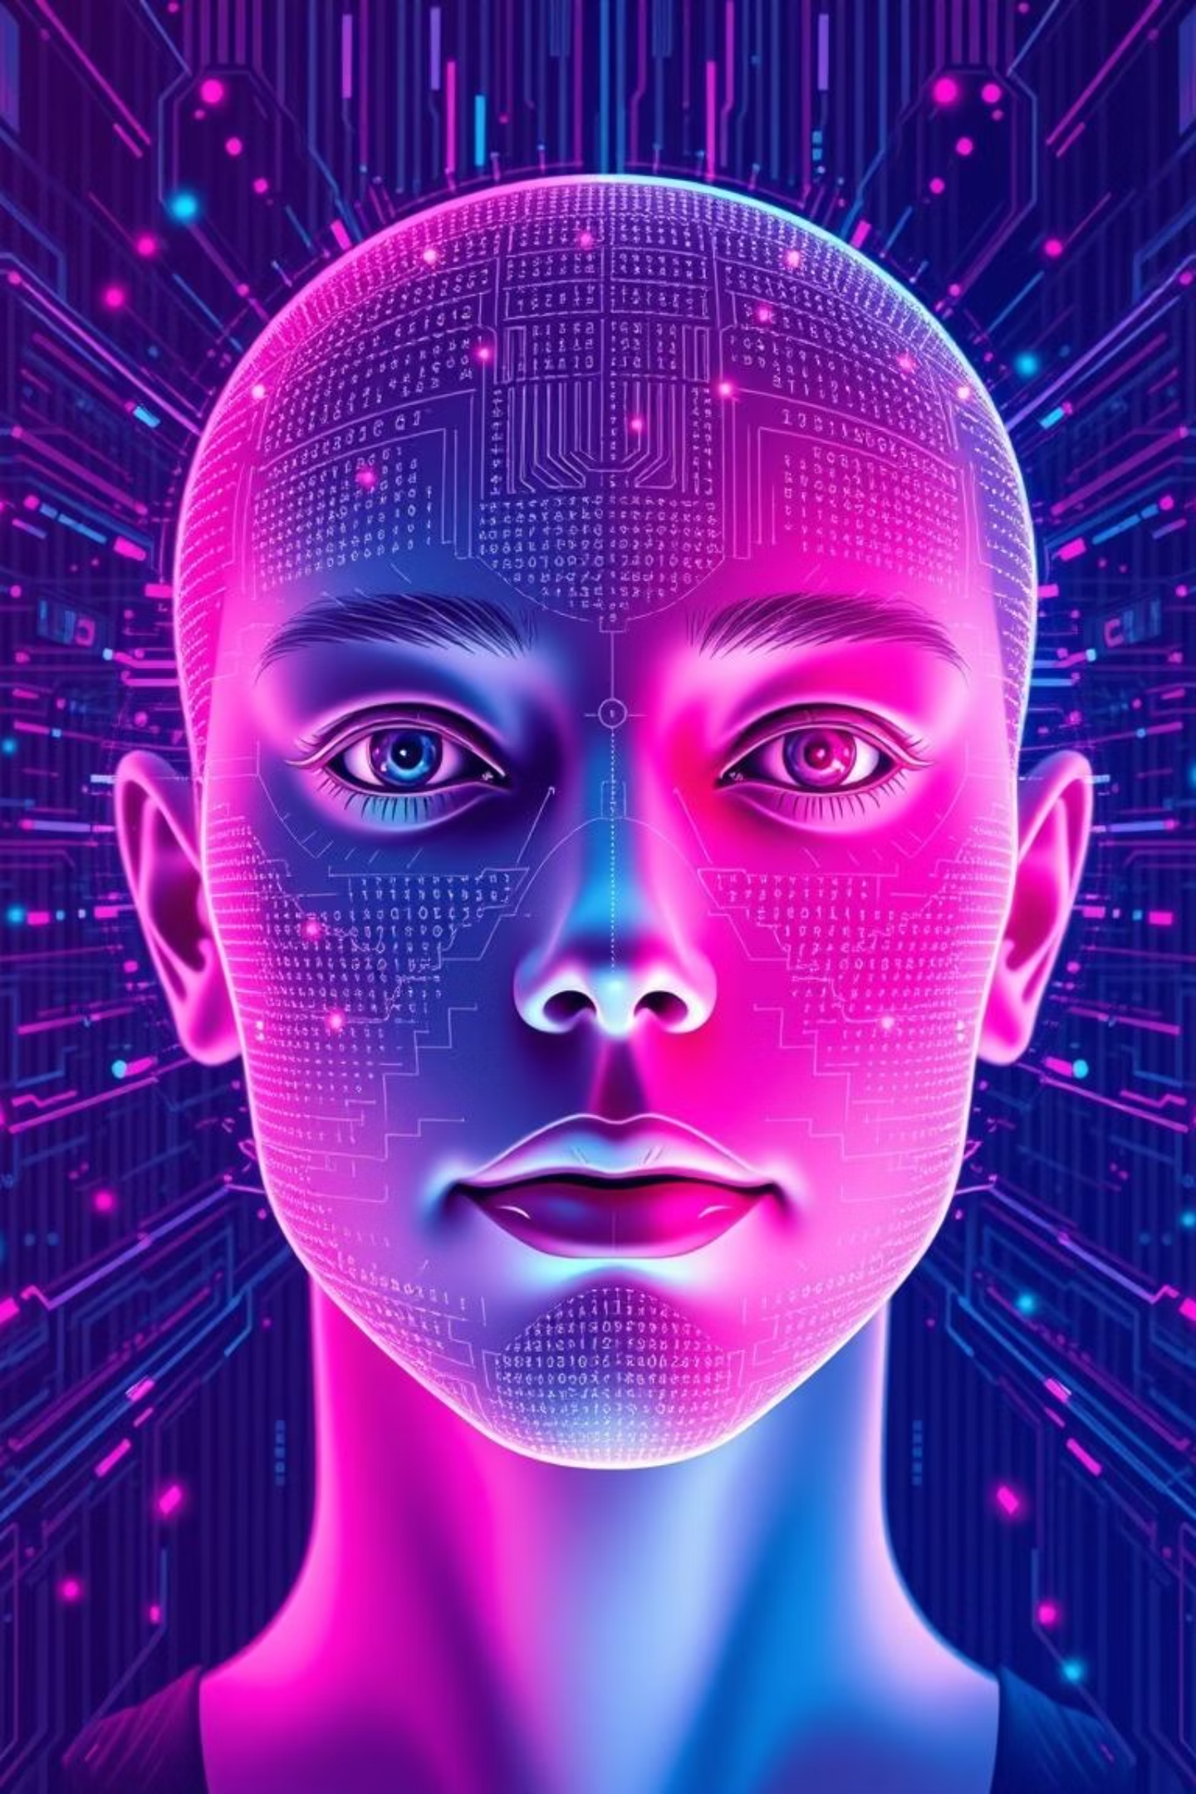
Emotector : Decoding Emotions, One Face at a Time
As an intern at TopNotch Solutions, I developed Emotector, a facial emotion detection system using deep learning.
Emotector : Decoding Emotions, One Face at a Time

Slide 2







Decoding the Spectrum of Emotion
Emotector is designed to go beyond simple positive or negative classifications. Our trained AI model can detect range of human emotions, providing a richer, more accurate understanding of an individual's state.
Happy
Sad
Angry
Recognizing genuine happiness, from subtle smiles to broad grins, indicating positive sentiment and engagement.
Identifying expressions of sorrow or melancholy, enabling empathetic responses and deeper insights into user experience.
Detecting frustration or aggression, crucial for customer service, conflict resolution, and user feedback analysis.
Surprise
Fear
Disgust
Capturing moments of astonishment or unexpected reactions, valuable for content effectiveness and engagement metrics.
Recognizing signs of apprehension or fear, important in safety assessments, user comfort, and stress detection scenarios.
Identifying aversion or strong disapproval, useful for product feedback, content filtering, and understanding user preferences.
Neutral
Distinguishing a lack of strong emotional display, serving as a baseline for comparison and a state of calm observation.
Emotector : Decoding Emotions, One Face at a Time

Slide 3

The Technology Behind Emotector
Emotector is a facial emotion detection system built using Python, Streamlit, OpenCV, NumPy, and TensorFlow/Keras, CNN.
Python – Programming language used to develop the entire system.
OpenCV – Used for reading, converting, and resizing facial images.
NumPy – Helped in efficient handling of image arrays and numerical data.
TensorFlow/Keras – Used to build, train, and save the CNN model.
Streamlit – Created a user-friendly web interface for emotion prediction.
CNN Model – Learned to classify emotions from facial image features.
Emotector : Decoding Emotions, One Face at a Time

Slide 4
Seamless User Experience: How It Works
The Emotector platform is designed for effortless interaction, ensuring that users can quickly and intuitively obtain emotion insights from their images. The process is streamlined from image input to result output, focusing on efficiency and clarity.
Image Upload
1
Users simply upload or paste an image containing one face directly into the web application. The system supports common image formats ( .jpg, .jpeg, .png ), making it accessible for various uses.
Model Processing
2
Upon image submission, model analyzes the facial expressions within the image.
Insightful Output
3
The model predicts the dominant emotion(s) and presents the results. Beyond just a label, Emotector provides a "wise thought" , context-aware commentary on the detected emotion, offering a deeper understanding.
Personalized Recommendation
4
Adding a unique touch, the platform suggests a song recommendation tailored to the detected emotion, aiming to either amplify or help shift the user's mood, creating a more engaging experience.
Downloadable Report
5
For record-keeping, users have the option to download a raw report of the emotion detection results in PDF format.
Emotector : Decoding Emotions, One Face at a Time

Slide 5
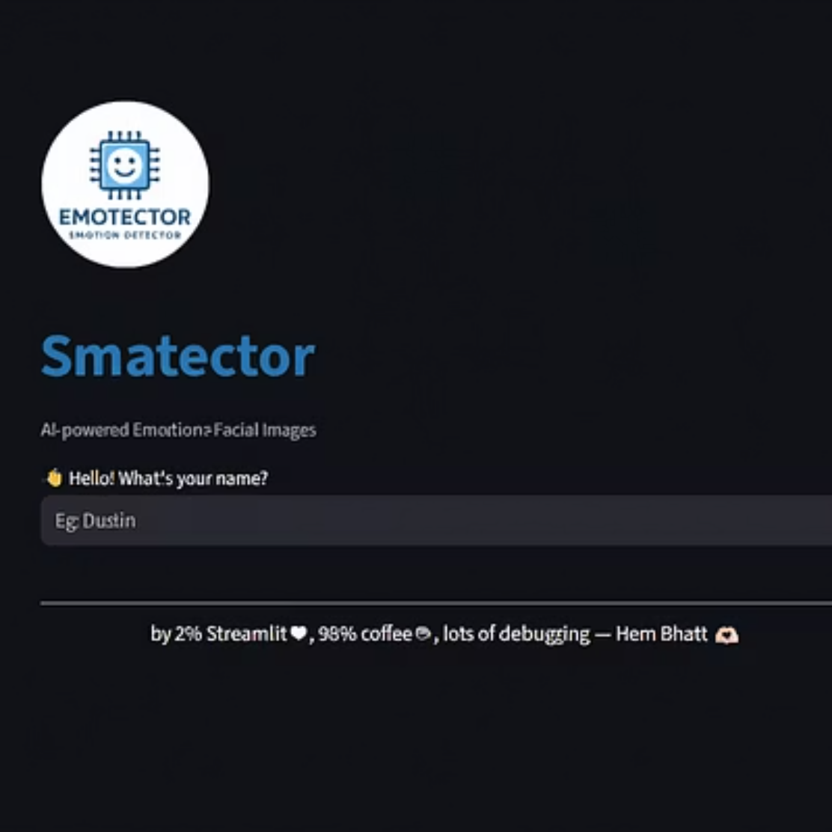
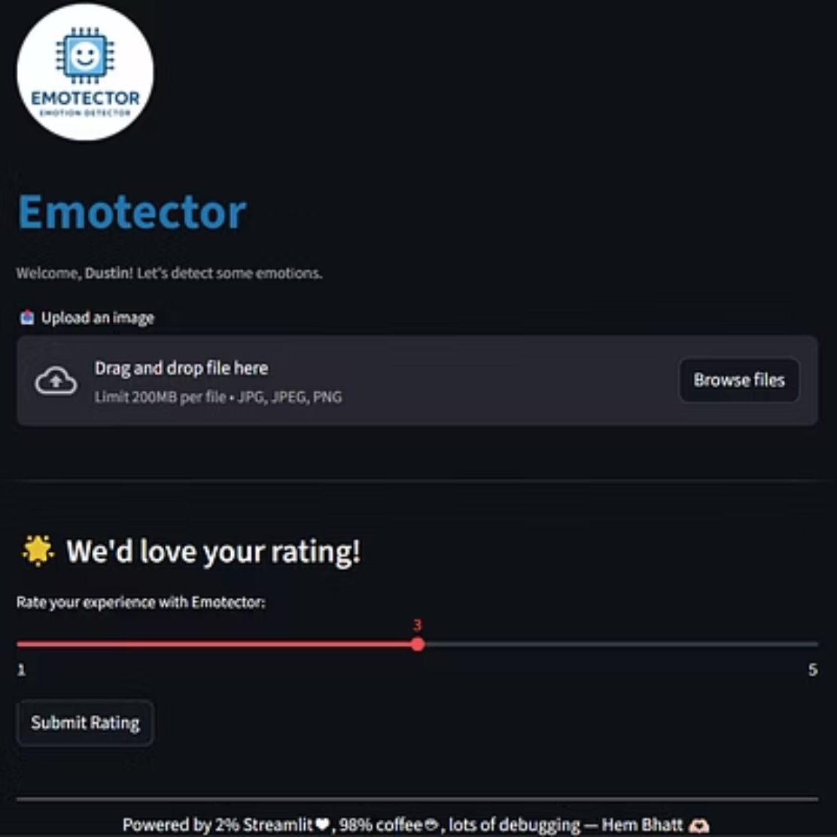
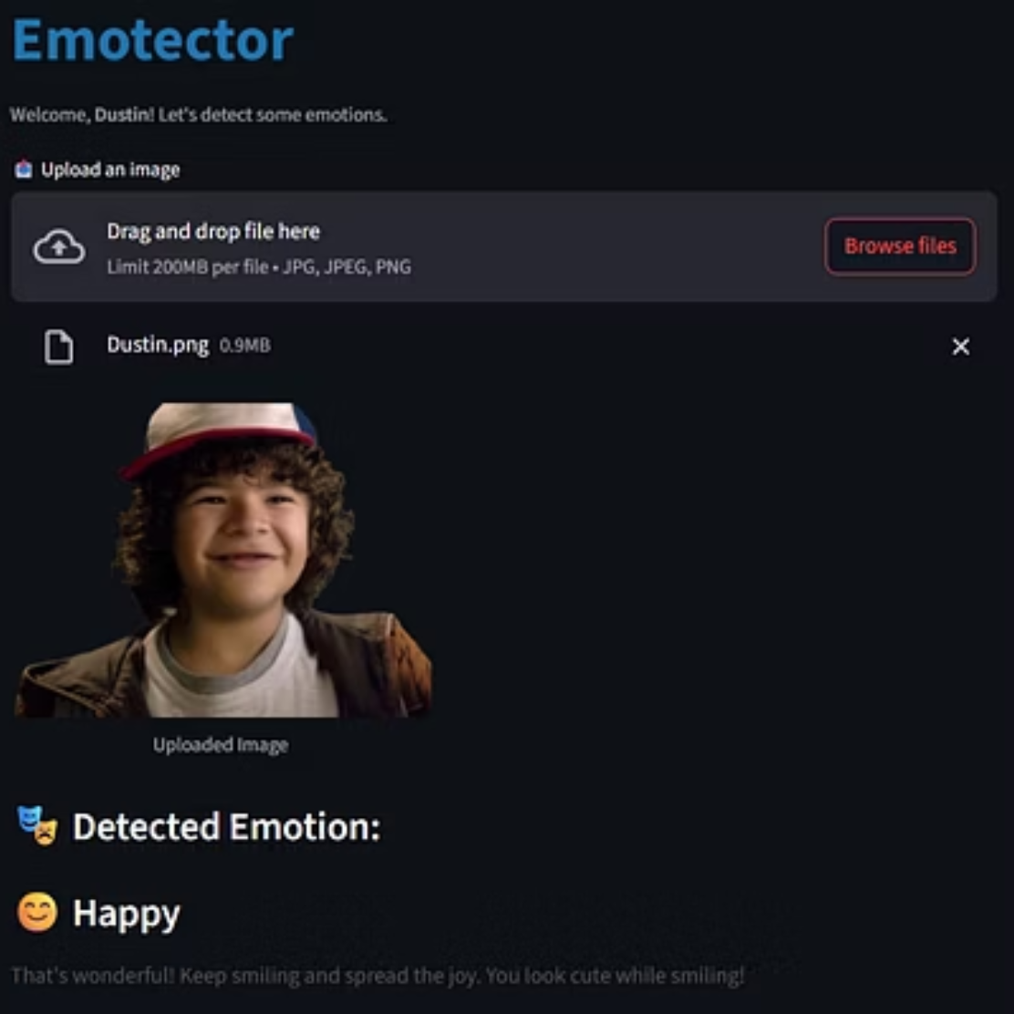
Current Project Screenshots
Emotector : Decoding Emotions, One Face at a Time

Slide 6
Future Prospects and Call to Collaboration
Emotector represents just the beginning of a journey into more sophisticated emotion AI. We will make future enhancement for better user interaction.
Enhanced Emotion
Real-Time Video Analysis
Further refining the model to detect micro-expressions and an even broader range of subtle emotional states, increasing accuracy and depth of analysis.
Expanding the platform's capabilities to process live video feeds, enabling dynamic emotion tracking for interactive applications, customer service, and more.
We are continuously working on deployment and we seek for your feedback to enhance user experience…
Emotector : Decoding Emotions, One Face at a Time

Slide 7

The Journey: Internship at TopNotch Solutions
Emotector was developed as a project during my internship at TopNotch Solutions. This invaluable experience provided the perfect environment for applying academic knowledge to real-world challenges.
Mentorship & Guidance: With daily meetings, insightful mentorship, and fun learning activities, I was able to grasp new concepts and confidently build this amazing project.
Practical Application: Translated theoretical machine learning concepts into a tangible, functional web application.
Skill Enhancement: Improved my skills in Python, Machine Learning, Streamlit, and software development, and gained a better understanding of how a project is planned and built.
Problem-Solving: Faced and overcame various technical hurdles, enhancing my analytical, debugging and problem-solving abilities.
This internship was instrumental in bringing Emotector from concept to a deployable product, reflecting the high standards and innovative spirit of TopNotch Solutions.
Emotector : Decoding Emotions, One Face at a Time

Slide 8

A heartfelt thank you to my mentor and team at TopNotch Solutions for making this experience truly rewarding.
~ Hem Bhatt
Emotector : Decoding Emotions, One Face at a Time

